Slide 1
Team Members
1- احمد ابراهيم علي عيده
2- احمد ابراهيم عبد ربه النجار
3- اثر محمد عبدالجواد مرسي مزروع

Slide 2
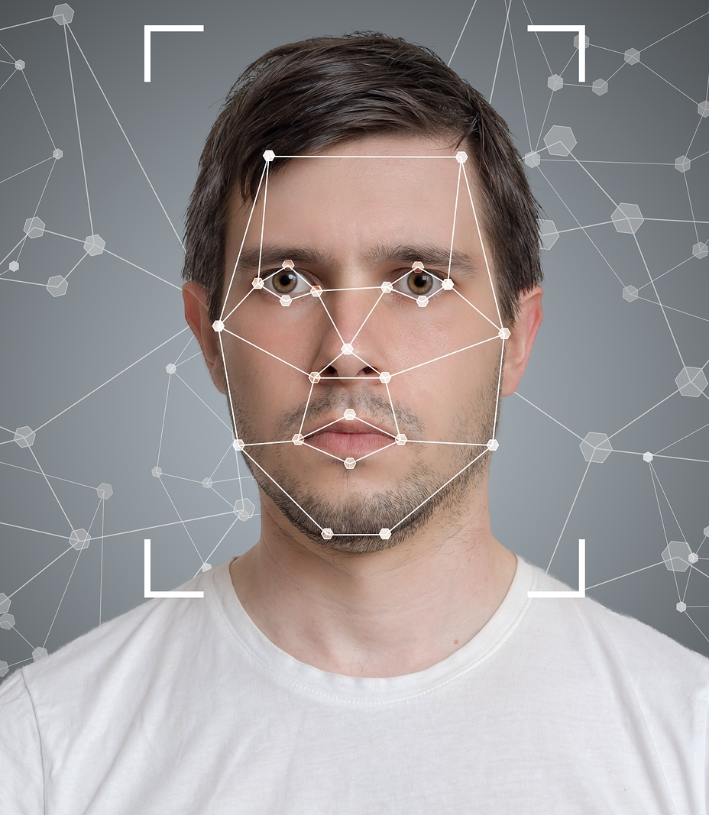
Face Recognition

Slide 3

Topics
Introduction
Importance of Face Recognition and its applications
Data Sets
Deep Learning Algorithms
Experiment Steps and How Face Recognition Works
Challenges and Limitations
Privacy and Ethical Considerations
Experiment Results
Suggestions for Future Work

Slide 4
Introduction
Welcome to this presentation that explores the face recognition system using Deep Learning algorithms. In this project, we analyze the importance of face recognition technology and how it can be achieved using advanced Deep Learning techniques.
What is Face Recognition Technology?
Face recognition technology is a biometric method used to identify or verify the identity of individuals based on their facial features. It analyzes unique patterns, such as the distance between the eyes, shape of the nose, and contours of the face, to create a digital representation of a person's face.

Slide 5
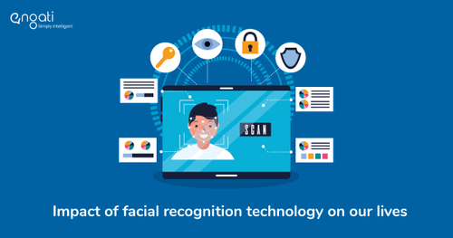
Importance of Face Recognition and its applications
Importance in Various Fields:
Face recognition technology opens up new horizons in several fields, including security, access control efficiency, and artificial intelligence applications. This technology is considered an innovative and secure solution for individual identification.
Face recognition technology has become increasingly important in various fields due to its accuracy and convenience. It is widely used for identity verification and authentication purposes, providing a secure and efficient method for access control and user authentication.

Slide 6
Applications of Face Recognition Technology
Application
Security Systems : Face recognition is widely used in security systems for access control and authentication. It can be used to grant or deny access to secure areas based on facial recognition of authorized individuals.
Surveillance : Face recognition technology is used in surveillance systems to identify and track individuals in real-time. It can be used to monitor public spaces, identify potential threats, and enhance public safety.
Access Control : Face recognition can be used for access control in various settings, such as airports, office buildings, and residential complexes. It allows for quick and secure identification of individuals, replacing traditional access methods like keycards or passwords.
Personalization in Consumer Devices : Face recognition is used in consumer devices, such as smartphones and laptops, for personalization features. It can be used to unlock devices, authenticate payments, and customize user experiences based on individual preferences.

Slide 7

Data Sets
To ensure the effective training of the face recognition system, we utilized a diverse set of datasets. These datasets include images of well-known faces and various scenarios to emphasize diversity in the data.

Slide 8
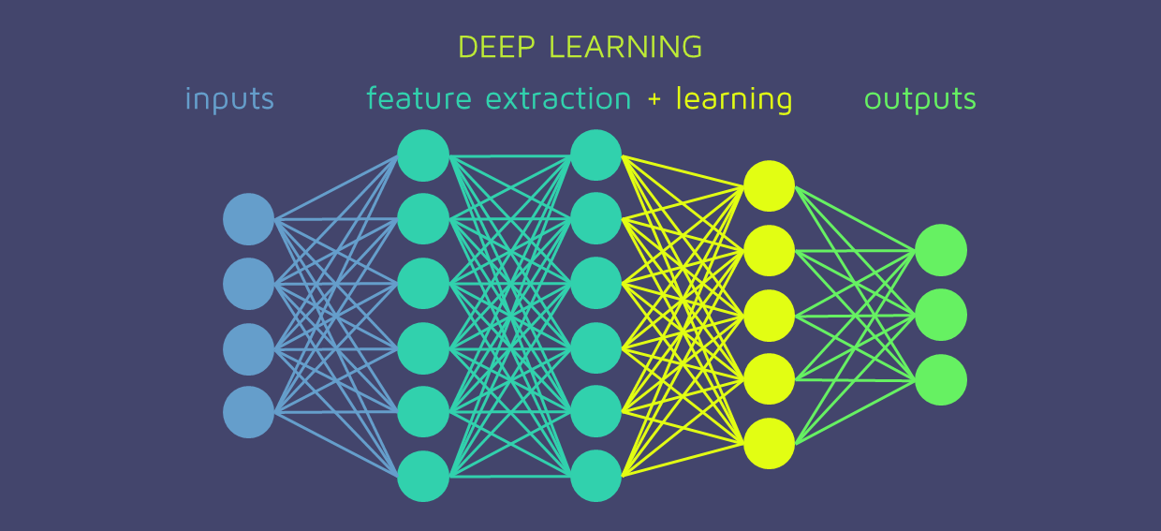
Deep Learning Algorithm
We employed Deep Learning algorithms such as Convolutional Neural Networks (CNN) to achieve optimal performance in face recognition. These deep neural networks help extract distinctive features from faces, leading to improved accuracy and efficiency.

Slide 9
Experiment Steps and How Face Recognition Works
Experiment Steps :
Data Collection: We gathered a wide range of images for training and testing, ensuring diversity in ages, genders, and ethnic backgrounds.
1
Model Training: We used Deep Learning algorithms to train the face recognition model using the collected data.
2
Model Evaluation: We assessed the model's performance using various accuracy and effectiveness tests.
3
Performance Improvement: We fine-tuned parameters and techniques to enhance the model's performance.
4

Slide 10
How Face Recognition Works
Facial Landmarks :
Face recognition technology uses facial landmarks, such as the position of the eyes, nose, and mouth, to identify unique features of an individual's face.
Feature Extraction :
Once the facial landmarks are detected, the technology extracts specific features from the face, such as the shape of the eyes, the distance between the eyes, and the curvature of the lips.
Pattern Matching Algorithms :
Pattern matching algorithms compare the extracted facial features with a database of known faces to find the closest match. These algorithms use mathematical techniques to calculate the similarity between the features.

Slide 11
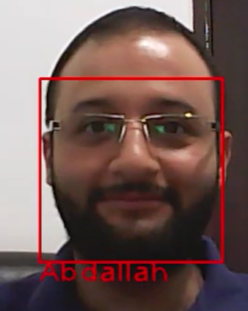
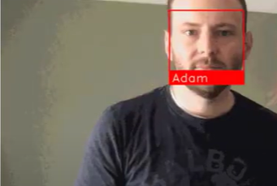
Experiment Results
Thanks to the use of Deep Learning techniques, the results achieved in face recognition were impressive. The accuracy reached high percentages, demonstrating the significant effectiveness of this technology in achieving its goal.

Slide 12
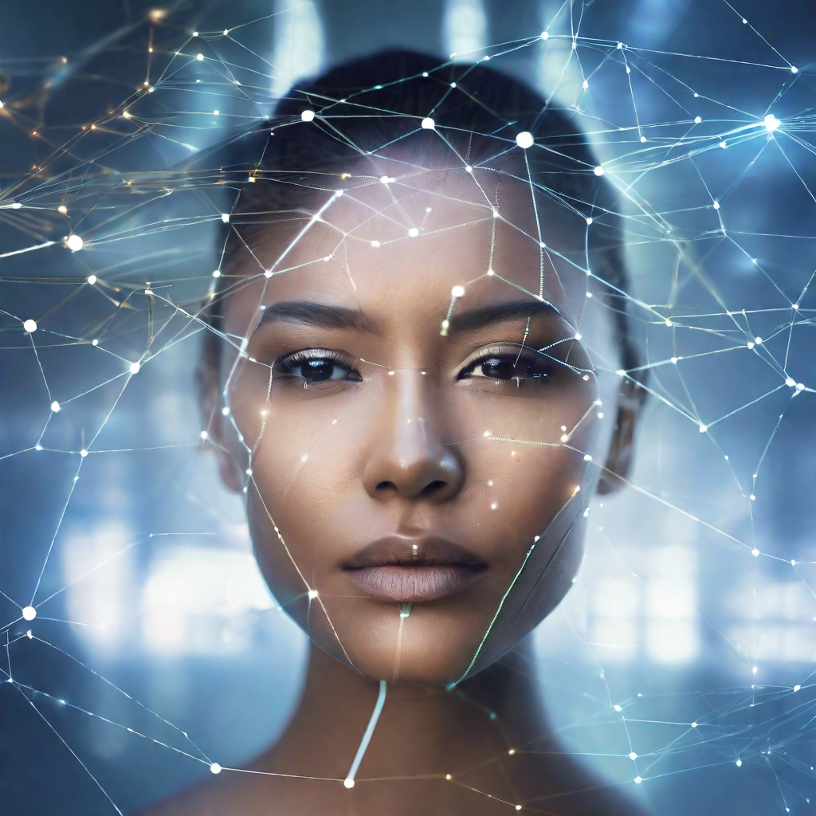
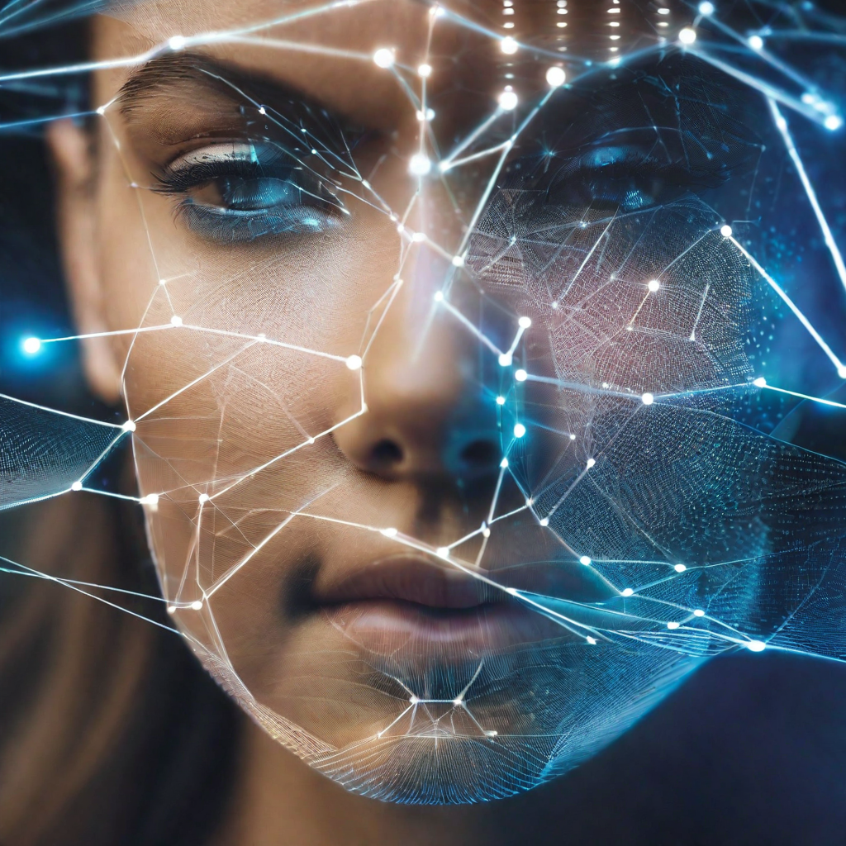
Challenges and Limitations
Accuracy Issues : Face recognition technology can sometimes produce false positives or false negatives, leading to inaccurate identification.
Bias and Discrimination : Face recognition algorithms have been found to exhibit bias and discrimination, particularly against certain racial or ethnic groups.
Privacy Concerns : The use of face recognition technology raises concerns about privacy, as it involves the collection and storage of individuals' biometric data.

Slide 13

Privacy and Ethical Considerations
Data Protection : The use of face recognition technology raises concerns about the protection of personal data. It is important to ensure that individuals' facial data is securely stored and only used for authorized purposes.
Consent : Obtaining informed consent from individuals before collecting and using their facial data is crucial. Transparency about the purpose and scope of data collection is essential to ensure individuals have control over their personal information.
Potential Misuse : The misuse of face recognition technology can have serious ethical implications. It is important to establish regulations and guidelines to prevent unauthorized access, discrimination, and abuse of facial data.

Slide 14
Suggestions for Future Work of face recognition
Advancements in Accuracy
I. Improved algorithms and machine learning techniques are enhancing the accuracy of face recognition systems.
II. Higher resolution cameras and better image processing capabilities are contributing to more precise identification.
Real-time Applications
I. Face recognition technology is being used for real-time surveillance and security applications, enabling quick identification and response.
II. It is also being integrated into mobile devices for secure authentication and unlocking features.
Integration with Other Technologies
I. Face recognition can be combined with artificial intelligence and machine learning to enable more advanced applications, such as emotion recognition and personalized user experiences.
II. Integration with augmented reality and virtual reality technologies can enhance immersive experiences and enable new forms of interaction.

Slide 15
conclusion
Face recognition technology using Deep Learning is a tremendous achievement in security and technology fields. By leveraging big data and advanced techniques, we are on the verge of a promising future for continuous development in this field.
Thank you for your attention and interest.

